Slide 1

7th Grade Math
Unit 13, Lesson 6 Comparing Data Sets and Graphs Volume 2, pg. 262

Slide 2


Benchmark
MA.7.DP.1.2
Given two numerical or graphical representations of data, use the measure(s) of center and measure(s) of variability to make comparisons, interpret results, and draw conclusions about the two populations.
volume 2, pg. 262

Slide 3
Integrated Mathematical Thinking and Reasoning Standards
MA.K12.MTR.2.1 Demonstrate understanding by representing problems in multiple ways.
MA.K12.MTR.4.1 Engage in discussions that reflect on the mathematical thinking of self and others.
MA.K12.MTR.6.1 Assess the reasonableness of solutions.
MA.K12.MTR.7.1 Apply mathematics to real-world contexts.
volume 2, pg. 262

Slide 4

Learning Target
I can compare and interpret a numerical representation of data of one population and a graphical representation of another population.
volume 2, pg. 262

Slide 5

Warm-Up
volume 2, pg. 262

Slide 6
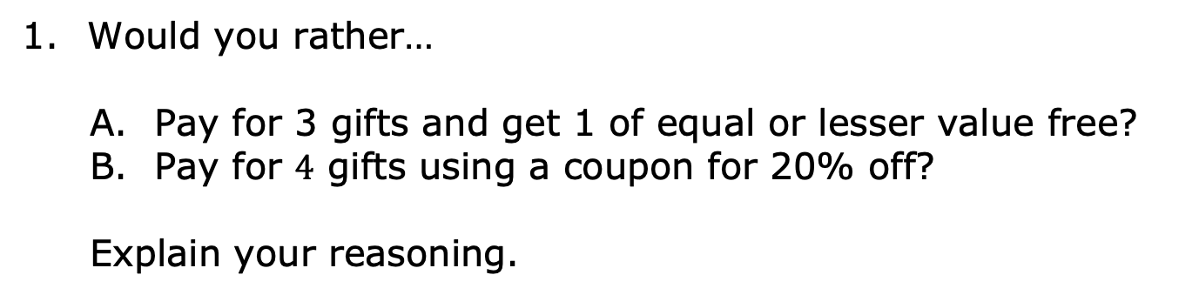
13.6.1 Warm-Up: Would You Rather?
volume 2, pg. 262

Slide 7

Guided Practice
volume 2, pg. 263

Slide 8

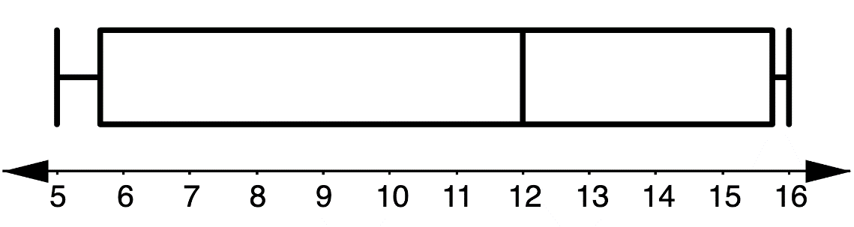
13.6.2 Guided Practice: Summarizing Data
The commute time, in minutes, for 24 randomly selected people in Duval County, Florida is shown.
The box plot displays the commute time, in minutes, for 24 randomly selected people in Union County, Florida.
9 | 10 | 15 | 17 | 18 | 20 | 20 | 21 | 22 | 23 | 24 | 25
25 | 25 | 25 | 26 | 26 | 29 | 29 | 29 | 32 | 34 | 38 | 40
Travel Time in Union County, Florida
Time (in minutes)
volume 2, pg. 263

Slide 9
Explain why it would be beneficial to create a box plot of the Duval County data when comparing these data sets.
What are some measures used to describe data that cannot be determined from a box plot?
volume 2, pg. 263

Slide 10
Use at least three terms from the term bank below to write a three-sentence summary comparing travel times to work in Duval County to travel times to work in Union County.
mean median range IQR
center variability upper quartile
lower quartile sample population
volume 2, pg. 263

Slide 11

Try It
volume 2, pg. 264

Slide 12

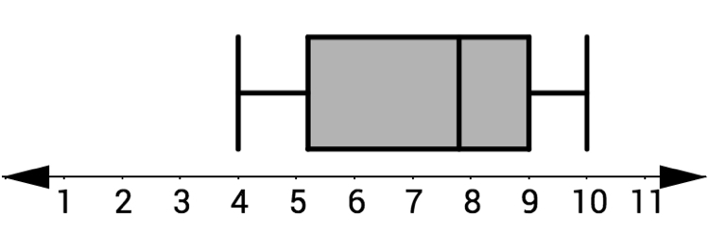
13.6.3 Try It: Comparing Data Sets and Graphs
The Deltona High School Wolves and Wildwood High School Wildcats cross-country teams ran an obstacle course. Each team’s times are summarized.
Deltona HS Wolves’ Obstacle Course Times
4 : 25 | 4 : 43 | 4 : 49 | 5 : 02 | 5 : 12
5 : 21 | 5 : 31 | 5 : 32 | 5 : 37 | 5 : 52
5 : 54 | 6 : 08 | 6 : 20 | 6 : 26 | 6 : 33
6 : 48 | 6 : 53 | 7 : 16 | 7 : 23 | 8 : 05
Wildwood HS Wildcats’ Obstacle Course Times
Course Times
volume 2, pg. 264

Slide 13
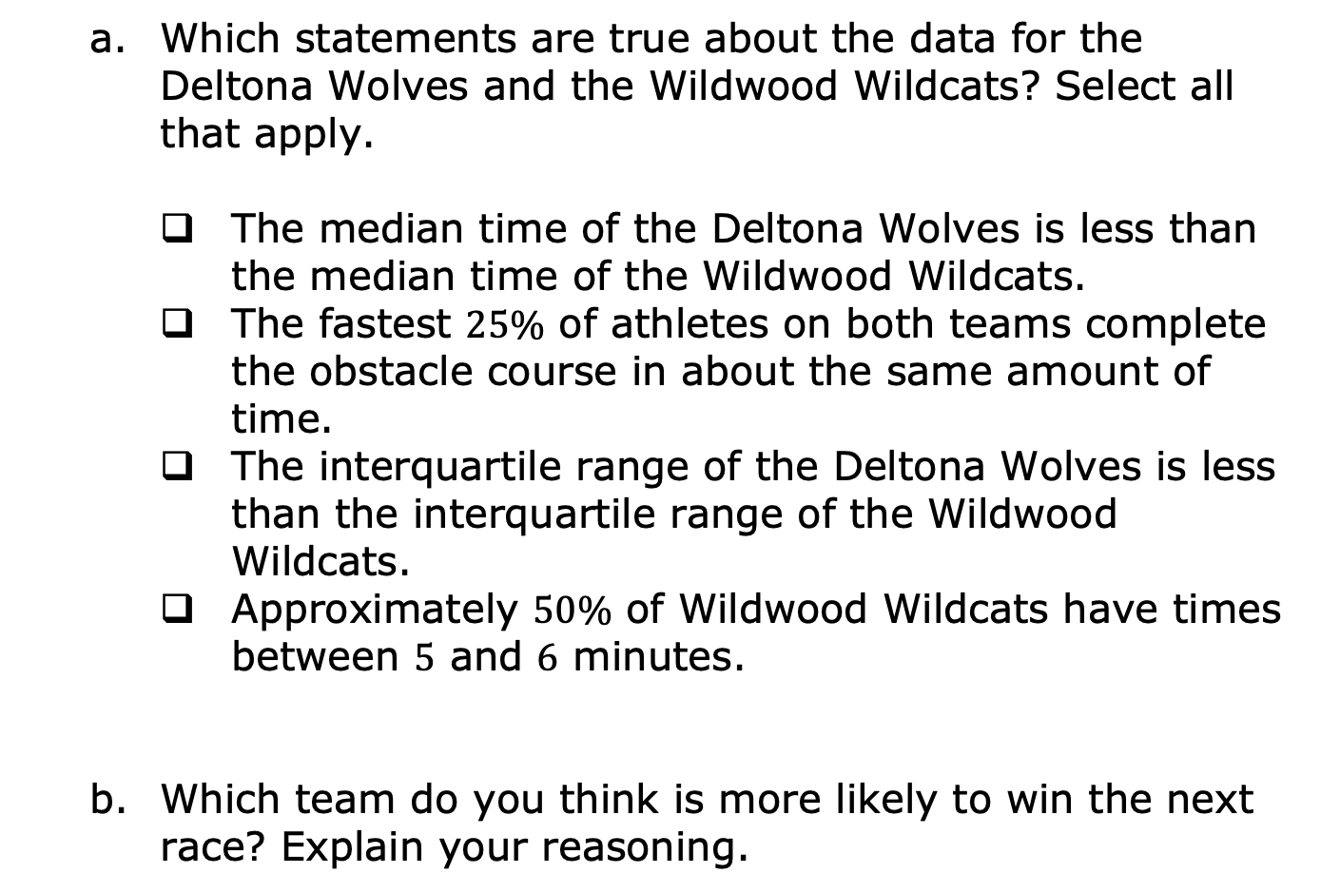
volume 2, pg. 264

Slide 14

Activity
volume 2, pg. 265

Slide 15

13.6.4 Activity: Roll the Dice
With your partner, decide which of you will be “Partner 1” and “Partner 2.” Partner 1 will be creating a line plot and Partner 2 will be recording a data set.
Using a standard six-sided die, each person will roll one die 25 times. After each roll, record the results in either a line plot or numerical data set below, depending on if you are Partner 1 or Partner 2.
volume 2, pg. 265

Slide 16
When both partners are finished, copy their data below.
Line plot (Partner 1’s rolls):
Data set (Partner 2’s rolls):
volume 2, pg. 265

Slide 17
Complete the table by calculating the measures of center and spread for your data. Share your data with your partner and add their data to the table.
 | Partner 1 | Partner 2
Mean
Median
Range
IQR
volume 2, pg. 265

Slide 18
With your partner, discuss similarities and differences in your data. Summarize your discussion in the table.
Similarities | Differences
volume 2, pg. 265

Slide 19

Your Turn
volume 2, pg. 266

Slide 20
13.6.5 Your Turn!
A group of ten rowers that practice outdoors on the water (Group 1) are challenging a group of ten who use indoor rowing machines (Group 2). They want to see who can row faster using rowing machines.
The time, in minutes, it took each of the ten rowers in Group 1 to row 500 meters on the rowing machine is represented in the stem-and-leaf plot.
Group 1: Outdoor Rower Times (in minutes)
Stem | Leaf
15 | 2, 8
16 | 8
17 | 0, 5, 8
18 | 0, 2, 3, 7
Key: 15|2 = 1.52
The time, in minutes, it took each of the ten rowers in Group 2 to row 500 meters on the rowing machine is represented in the data set.
{1.63, 1.82, 1.95, 1.97 2.0, 2.02, 2.12, 2.20, 2.25, 2.88}
volume 2, pg. 266

Slide 21
For each statement, state whether it is true or false. For any statements that are true, explain why.
Statement | True or False? | Explanation
The center of the Group 1 times is similar to the center of the Group 2 times.
The variability of the Group 1 times is similar to the variability of the Group 2 times.
The Group 1 rowers that practice on the water are typically faster than the Group 2 rowers that row on machines.
The Group 1 rowers that practice on the water are more consistent than the Group 2 rowers that row on machines.
volume 2, pg. 266

Slide 22
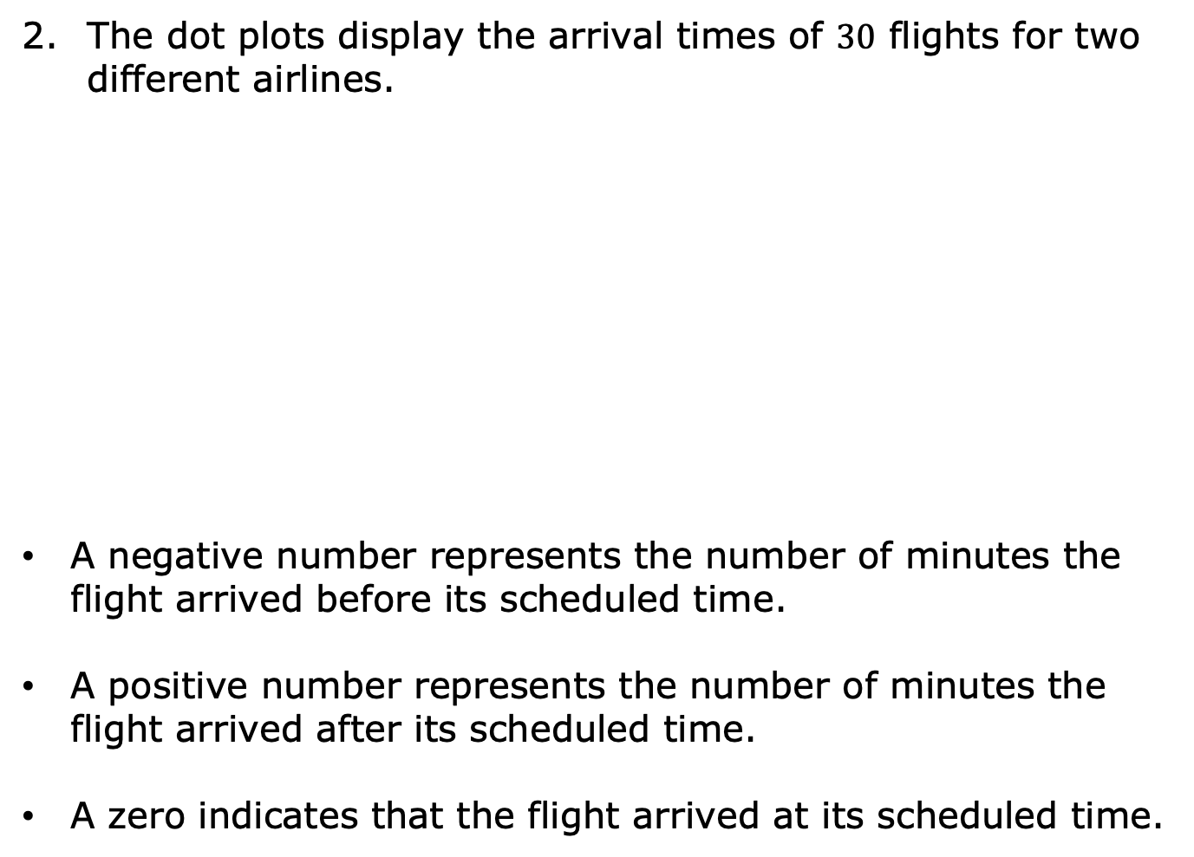
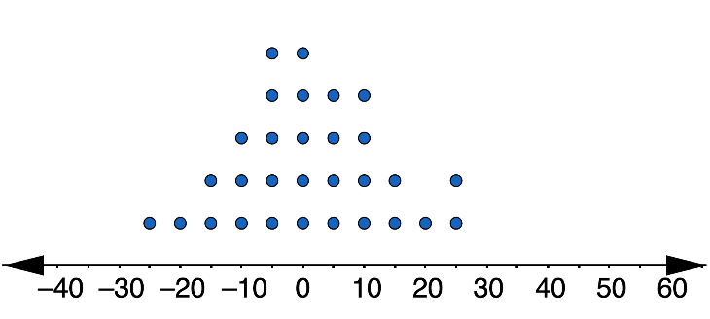
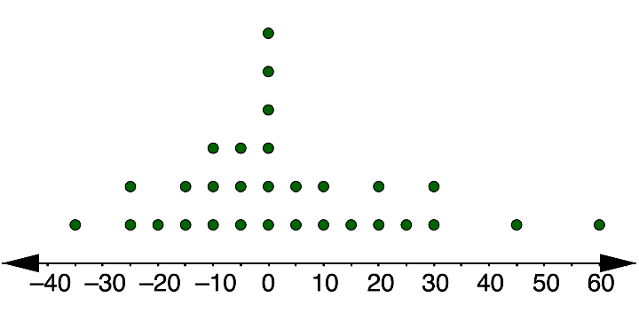
Arrival Times of Airline P
Arrival Times of Airline Q
volume 2, pg. 267

Slide 23
Based on the data, from which airline would you choose to buy your ticket? Use measure(s) of center and variability to justify your choice.
volume 2, pg. 267

Slide 24

Wrap-Up
volume 2, pg. 268

Slide 25
13.6.6 Wrap-Up: Cool Down
Write a short note to a classmate who missed class summarizing today’s lesson.
volume 2, pg. 268

